Slide 1
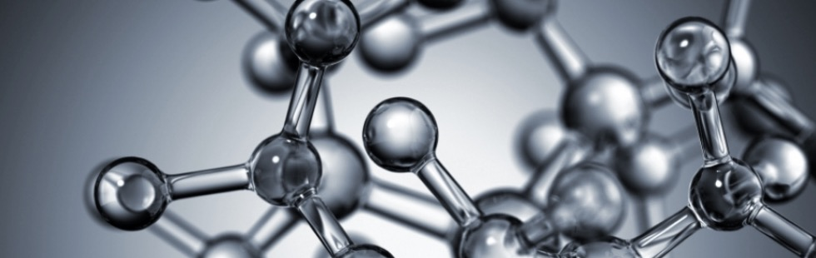
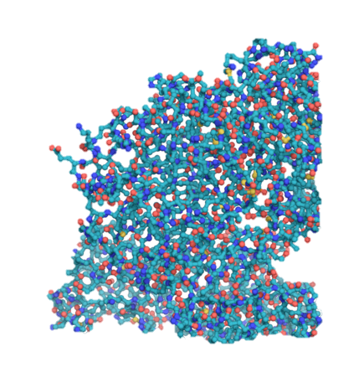

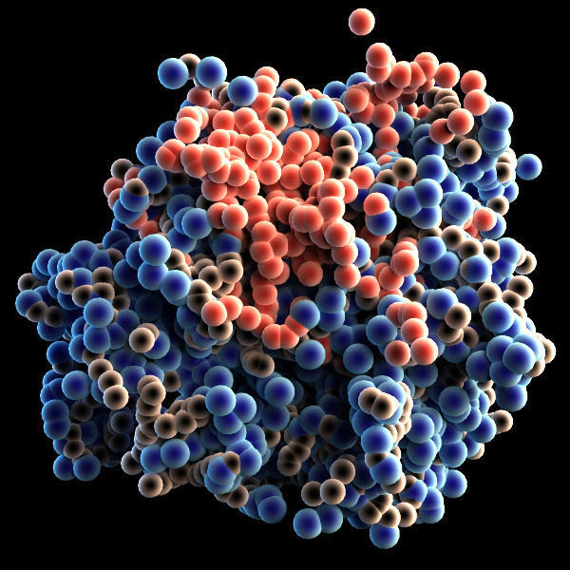
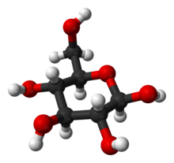
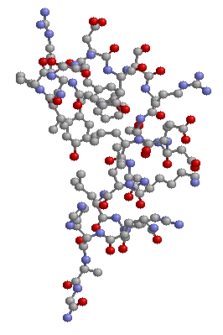


Artificial Chemistries
Basic examples
Daniel Rodríguez Cárdenas
Carlos Andrés Sierra
Alife research group,
Universidad Nacional,
Bogotá, Colombia.
Notes:
© Copyright Showeet.com – Free PowerPoint Templates

Slide 2
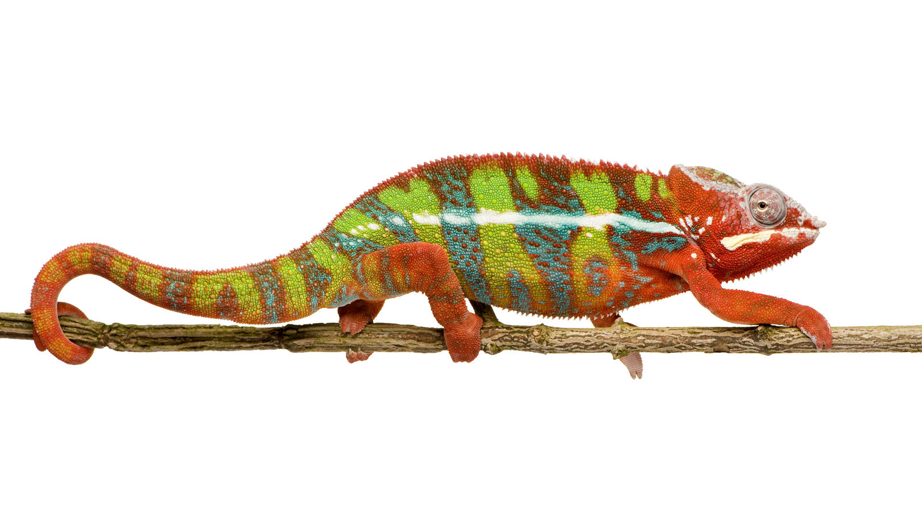
A nonconstructive Explicit Chemistry
A colony of chameleons includes 20 red, 18 blue and 16 green individuals.
Whenever two chameleons of different color meet, each changes to the third color.
Some time passes during which no chameleons born or die, nor do any enter or leave the colony.
Is it possible that at the end of this period all 54 chameleons are the same color?
NO!

Slide 3

The chameleons problem
20
18
16

Slide 4
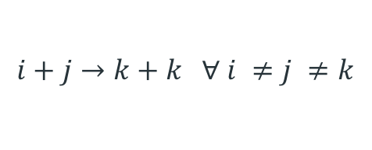
Chameleons rules
r + g -> b + b
r + b -> g + g
b +g -> r +r
$$i+j→k+k ∀ i ≠j ≠k$$
Where i stands for any chameleon with color i and indices i,j,k run through r,g,b colors

Slide 5
The chameleons algorithm
While not terminate() do
s1 := draw(P);
s2 := draw(P);
If (s1 not equal s2)
then
P:= remove(P,s1,s2);
P:= insert(P,s3,s3);
fi
od

Slide 6
The chameleons reaction table
 | reactants |  |  | products
rules | r | g | b | r | g | b
r1 | 1 | 1 |  |  |  | 2
r2 | 1 |  | 1 |  | 2
r3 |  | 1 | 1 | 2
The chameleons reaction rules

Slide 7
The chameleons generations
A total of 5400 chameleons is simulated, only read and blue chameleons are present at starting point

Slide 8
| The model with diferential equations

Slide 9




Chameleons concentration vector
$$\vec{x}\left(t\right)=\left(x_{r}\left(t\right),x_{g}\left(t\right),x_{b}\left(t\right)\right)$$
Where $x_{r}$, $x_{g},x_{b}$ denote the concentration of chameleon types r,g,b at time t.
$$\frac{dx_{r}}{dt}=2x_{g}x_{b}−x_{r}x_{b }−x_{r}x_{g}$$
$$\frac{dx_{g}}{dt}=2x_{r}x_{b}−x_{g}x_{b }−x_{r}x_{g}$$
$$\frac{dx_{b}}{dt}=2x_{r}x_{g}−x_{b}x_{r }−x_{b}x_{g}$$

Slide 10
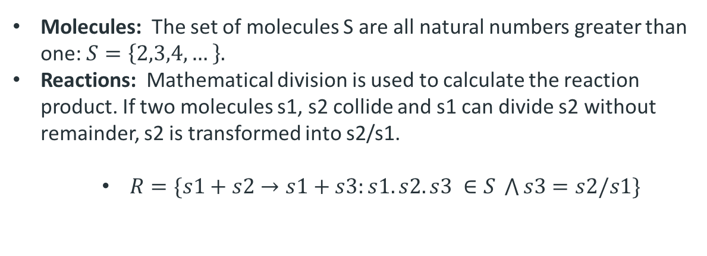
A constructive Implicit Chemistry
Molecules: The set of molecules S are all natural numbers greater than one: $S=\left\{2,3,4,…\right\}.$
Reactions: Mathematical division is used to calculate the reaction product. If two molecules s1, s2 collide and s1 can divide s2 without remainder, s2 is transformed into s2/s1.
$R=\{s1+s2→s1+s3:s1. s2.s3 ∈S \bigwedge{s3=s2/s1\}}$

Slide 11
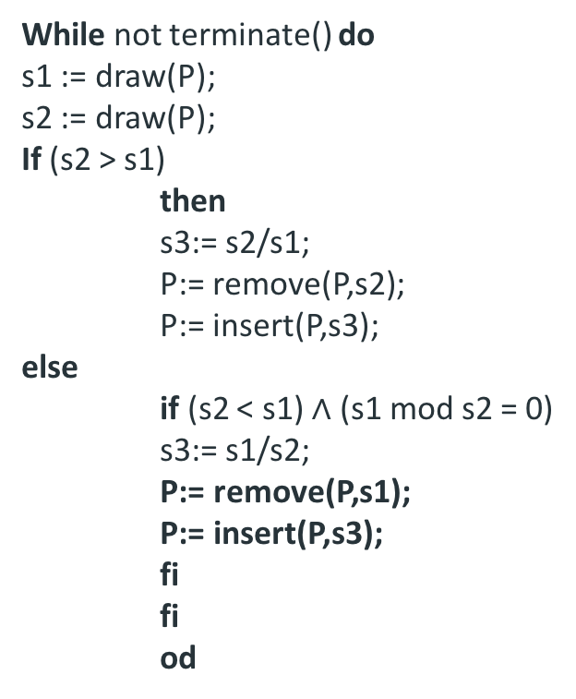
The numbers algorithm
Dynamics:
While not terminate() do
s1 := draw(P);
s2 := draw(P);
If (s2 > s1)
then
s3:= s2/s1;
P:= remove(P,s2);
P:= insert(P,s3);
else
if (s2 < s1) $∧$ (s1 mod s2 = 0)
s3:= s1/s2;
P:= remove(P,s1);
P:= insert(P,s3);
fi
fi
od

Slide 12
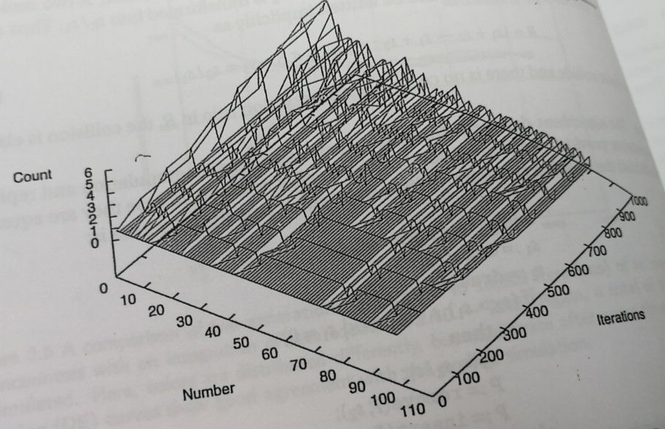

Slide 13
Primes emerge
From the initial status of the system, gradually more smaller numbers and primes are produces.
The smaller numbers futher react until all numbers are divided into primes.

